Slide 1
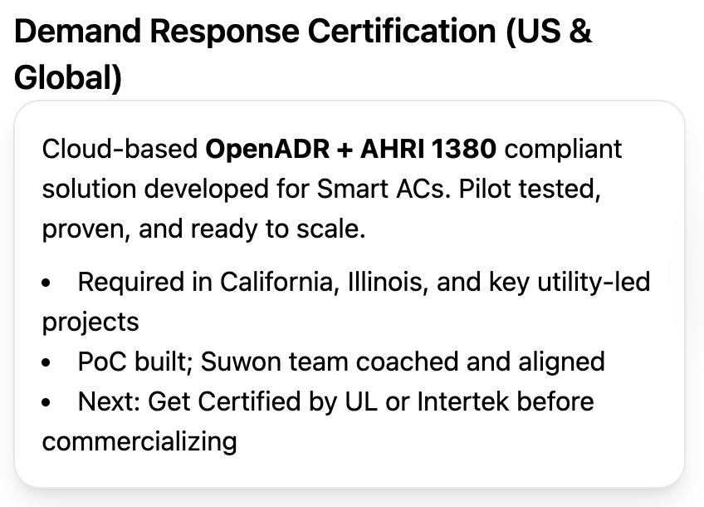
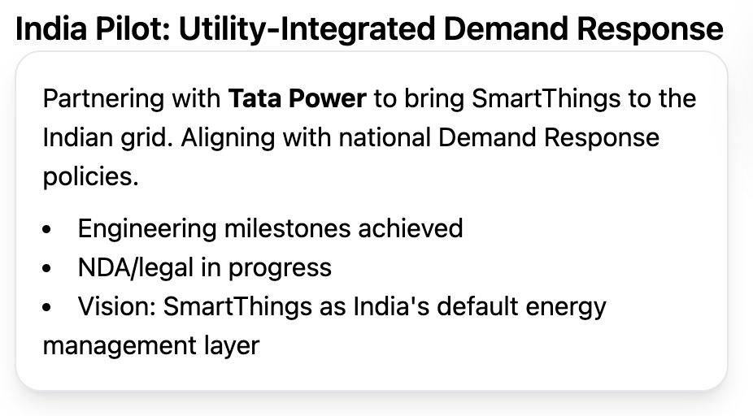
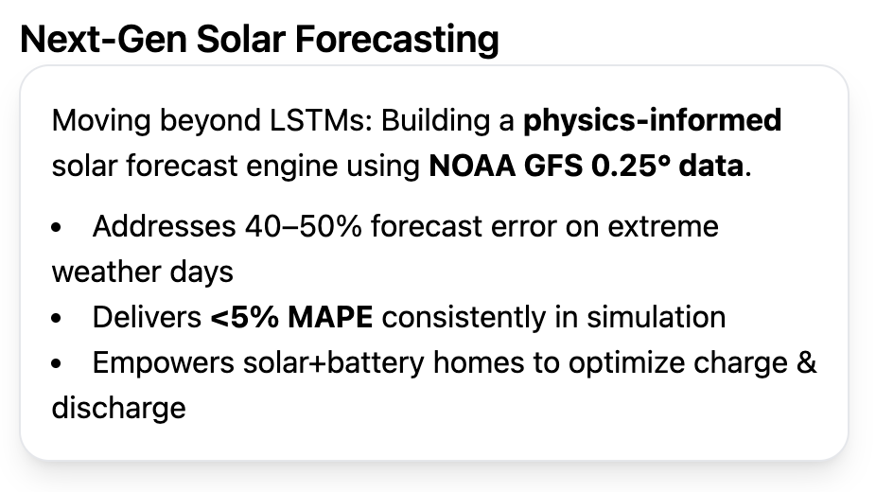
Energy Update Y25
Vision:
Make SmartThings the platform synonymous with energy management, for both Utilities and Users. (Like how Amazon is for shopping, connecting sellers and buyers)
Operational Thesis:
Enhance the grid interactivity of Samsung appliances through SmartThings to usher in the next era of responsive, efficient, and intelligent energy ecosystems.
Core Activities this year
Q3
Q3*
Q4
*subject to NDA and if more demand response events are available from Tata Power this year.

